Slide 1


Slide 2
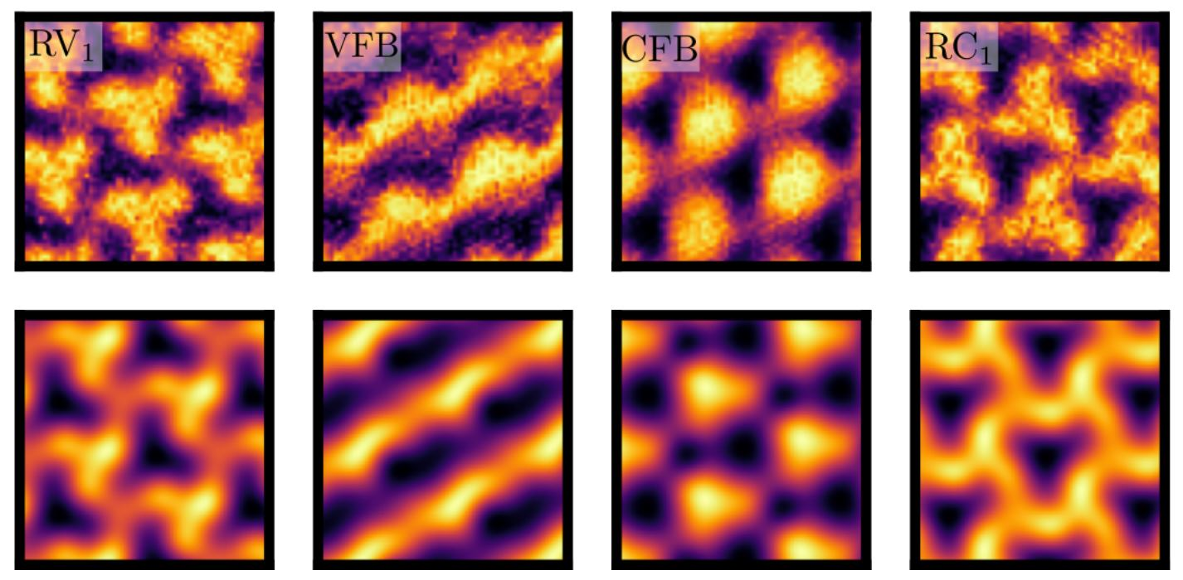
Interpretable ML
https://arxiv.org/pdf/2302.12274.pdf

Slide 3
Our Approach
Fisher Information
Method of describing a neural network from the perspective of information geometry
Can be used to optimize Gradient Descent
Applications in physics
Project overview:
Derived a new mathematical relationship between the trace of the Fisher Information and the NTK
Implemented and used this relationship for an example problem
Computed curvature for another simple machine learning example

Slide 4
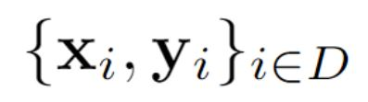
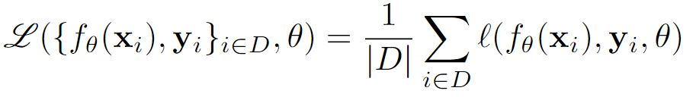
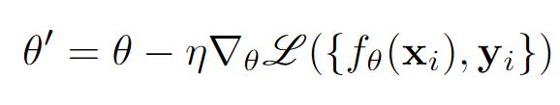
Supervised learning Framework
Network
Dataset
Loss Function
Gradient Descent
2

Slide 5
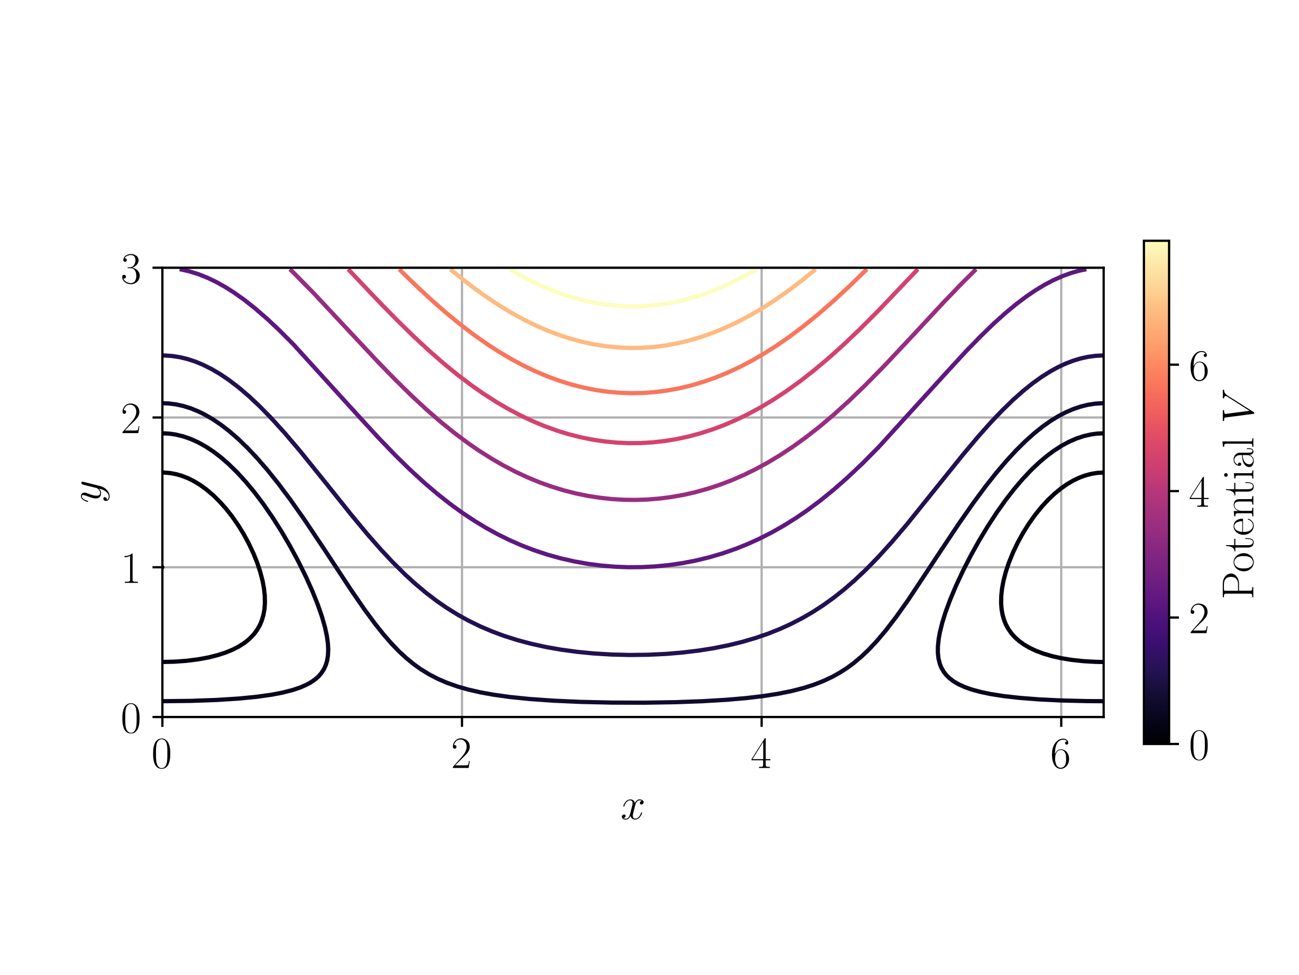
Gradient Descent
1
Notes:
Test

Slide 6
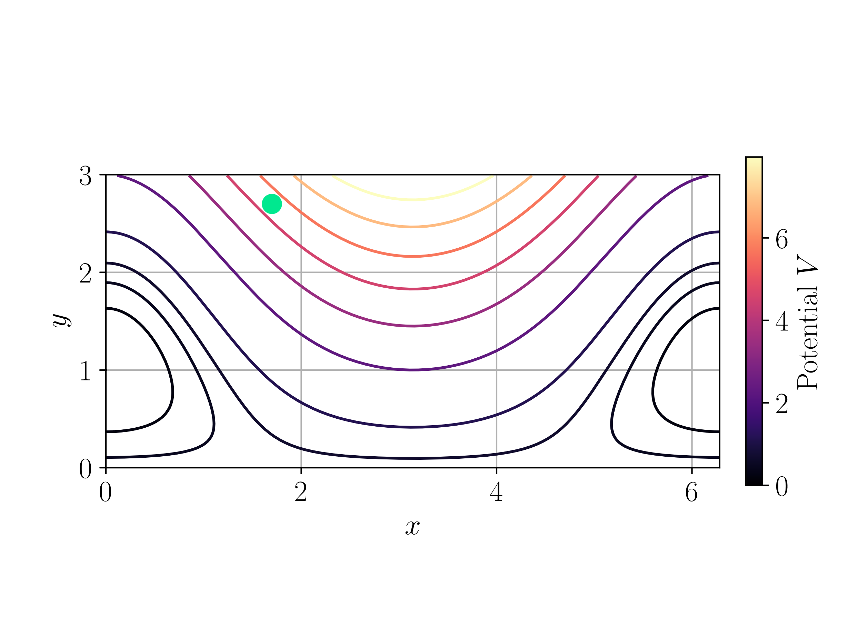
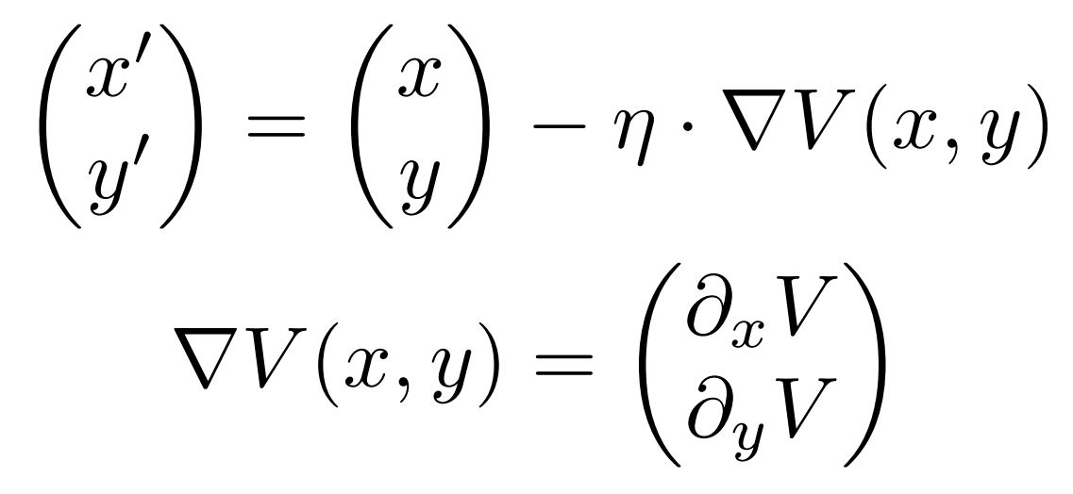
Gradient Descent
1

Slide 7
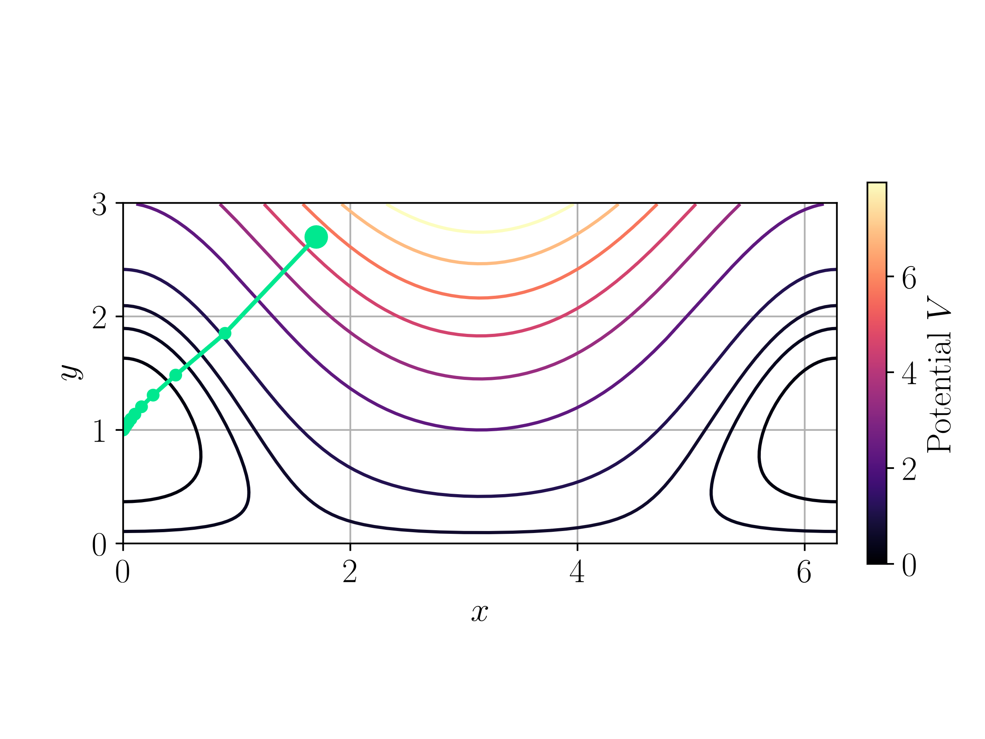
Gradient Descent
1

Slide 8
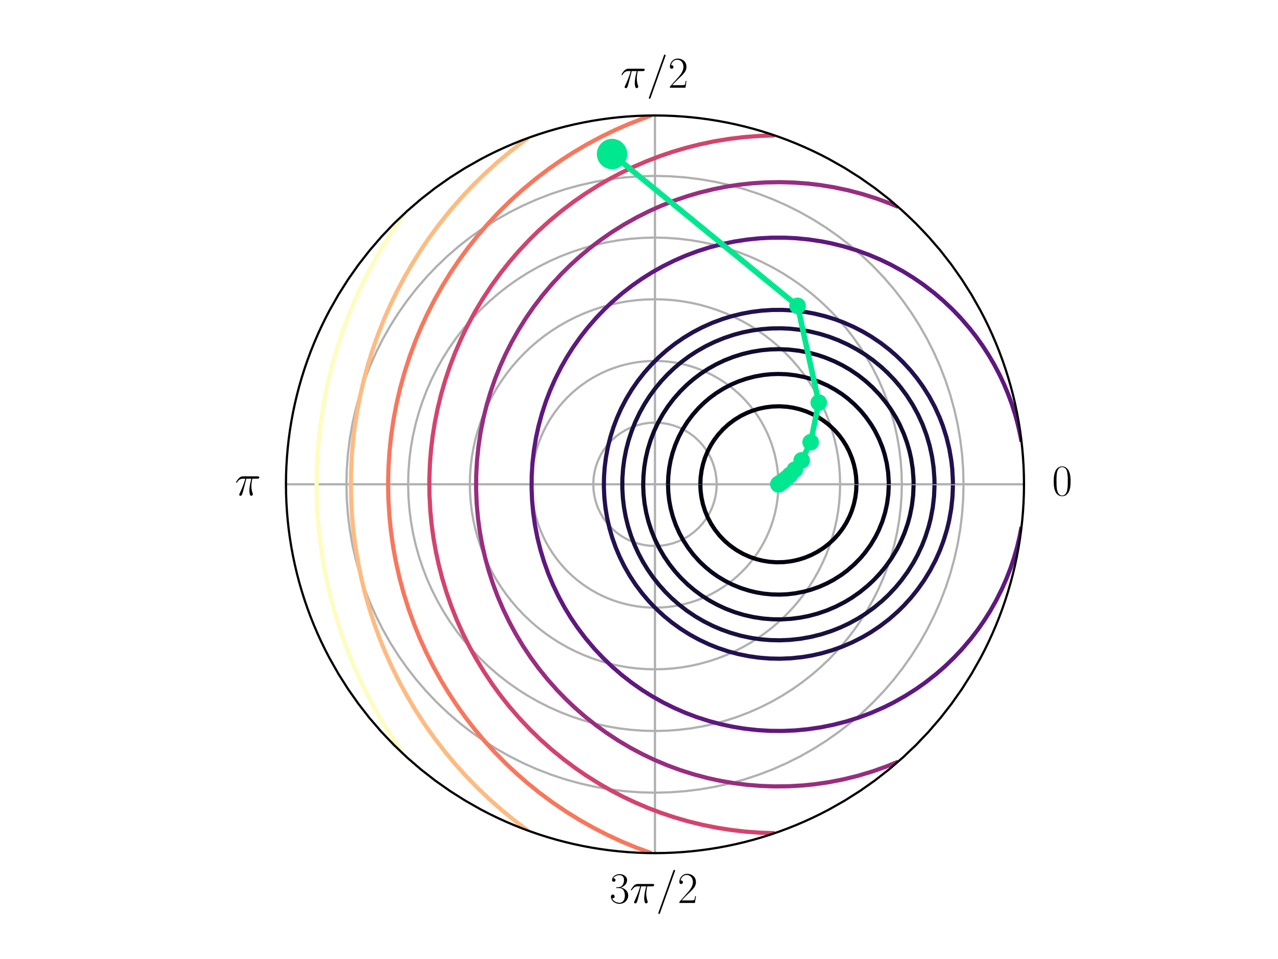

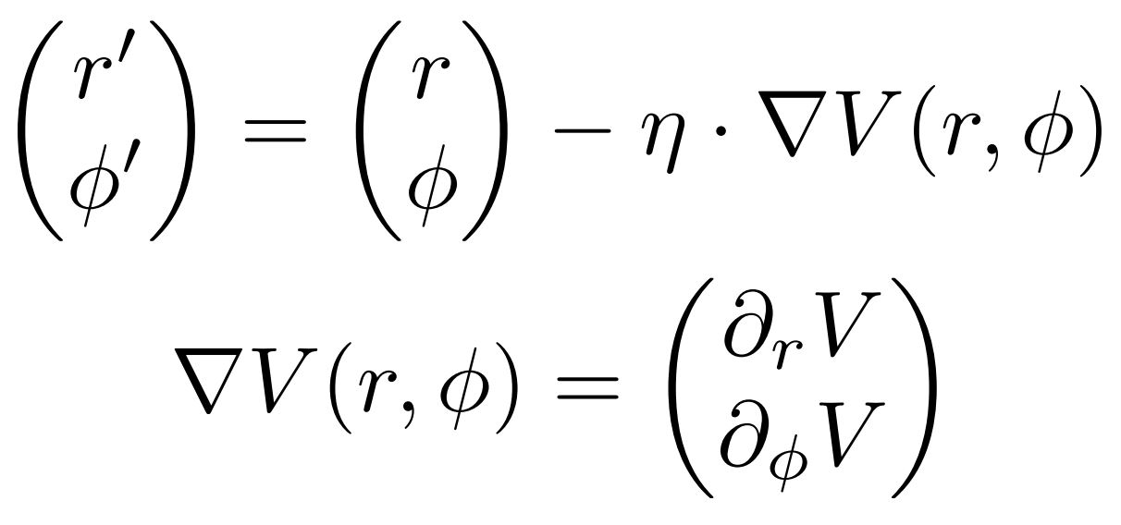
Gradient Descent
1

Slide 9
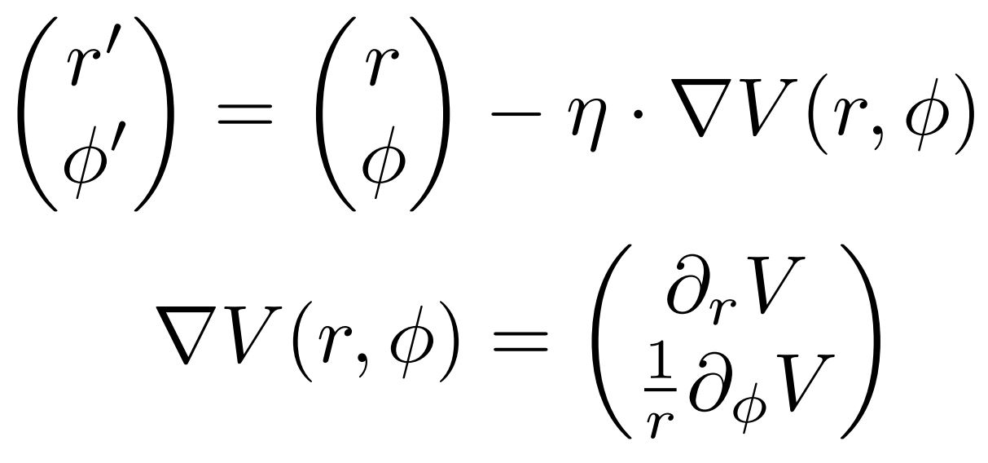
Gradient Descent
1

Slide 10
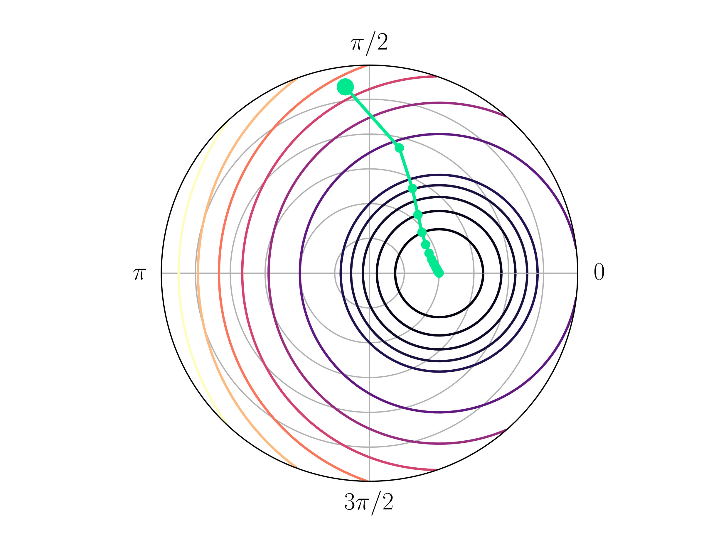
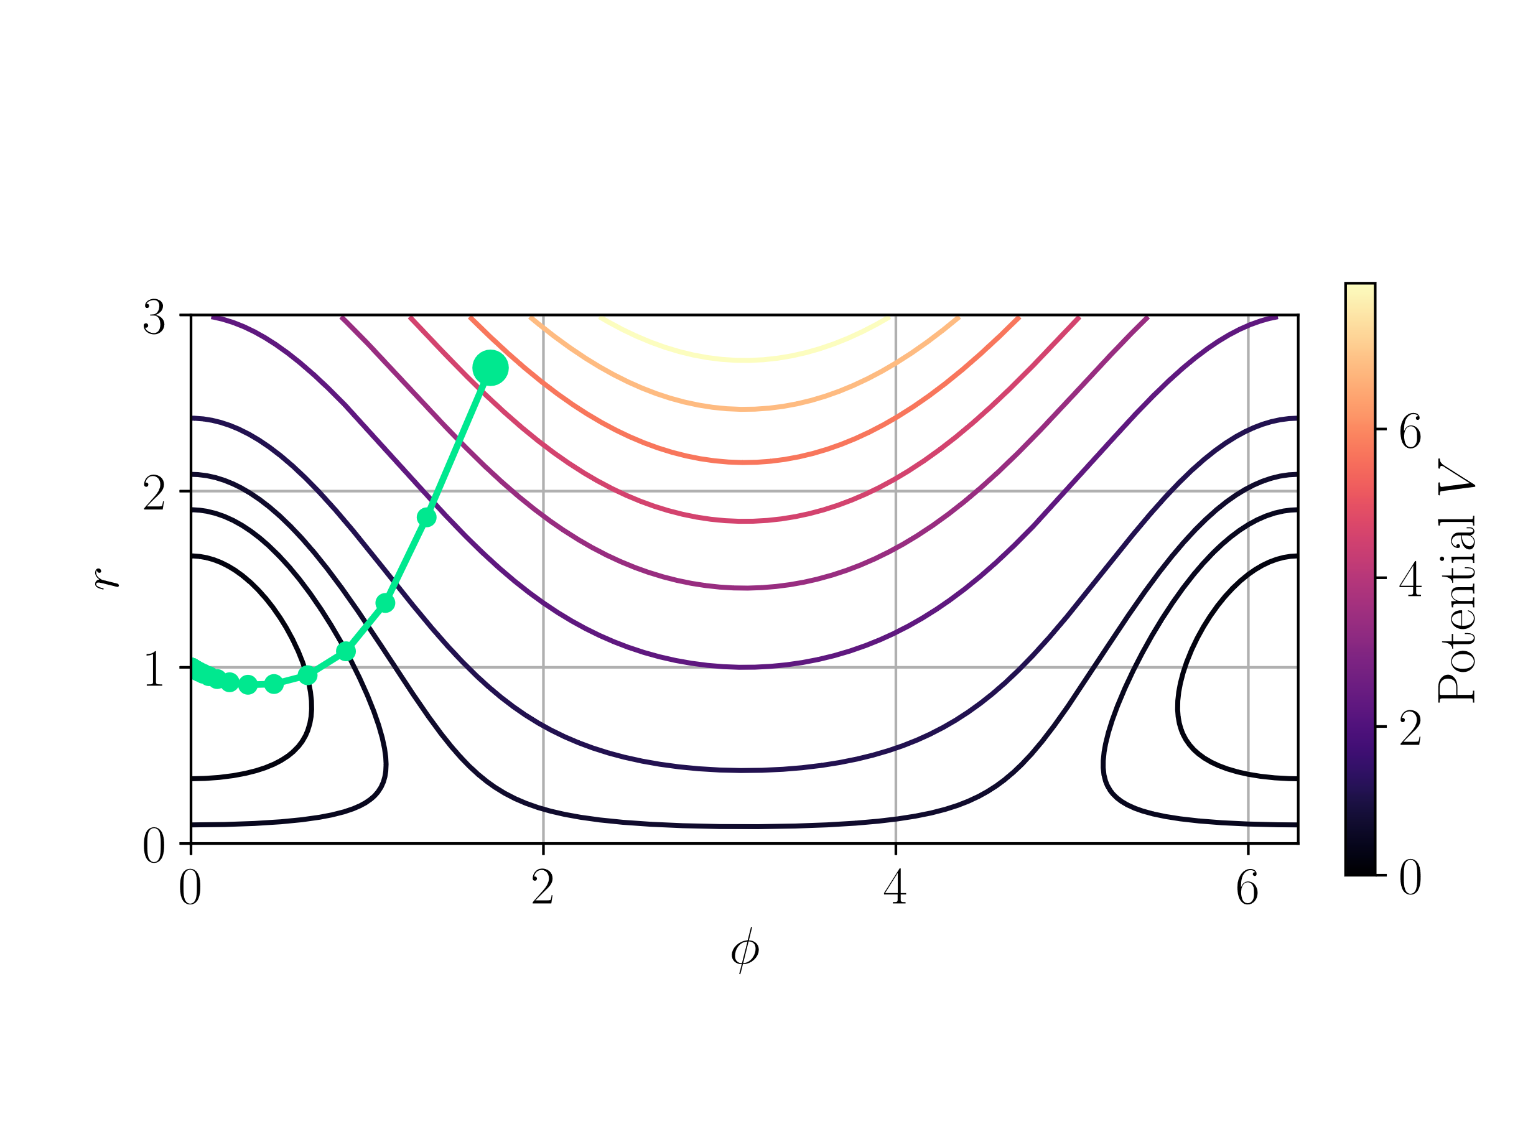
Gradient Descent
1

Slide 11
Supervised learning Framework
Network
Dataset
Loss Function
Gradient Descent
2

Slide 12
Supervised learning Framework
Network
Dataset
Loss Function
Natural Gradient Descent
2

Slide 13
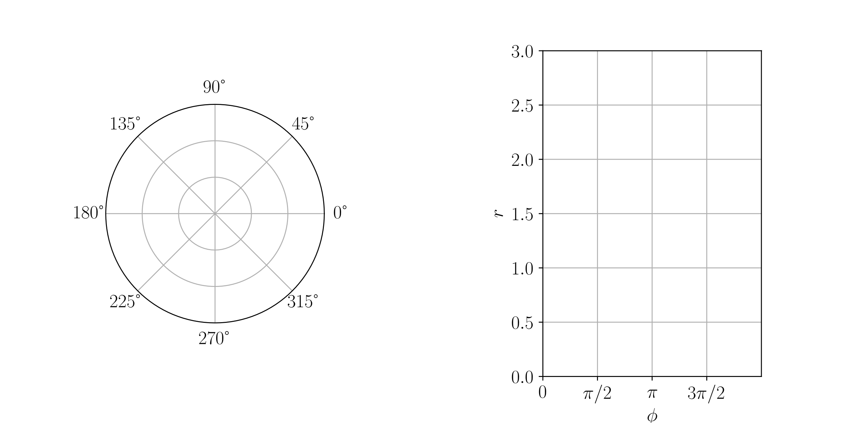
Manifolds and Metrics
Definition:
A manifold is a topological space that is locally isomorphic to euclidean space.
3

Slide 14
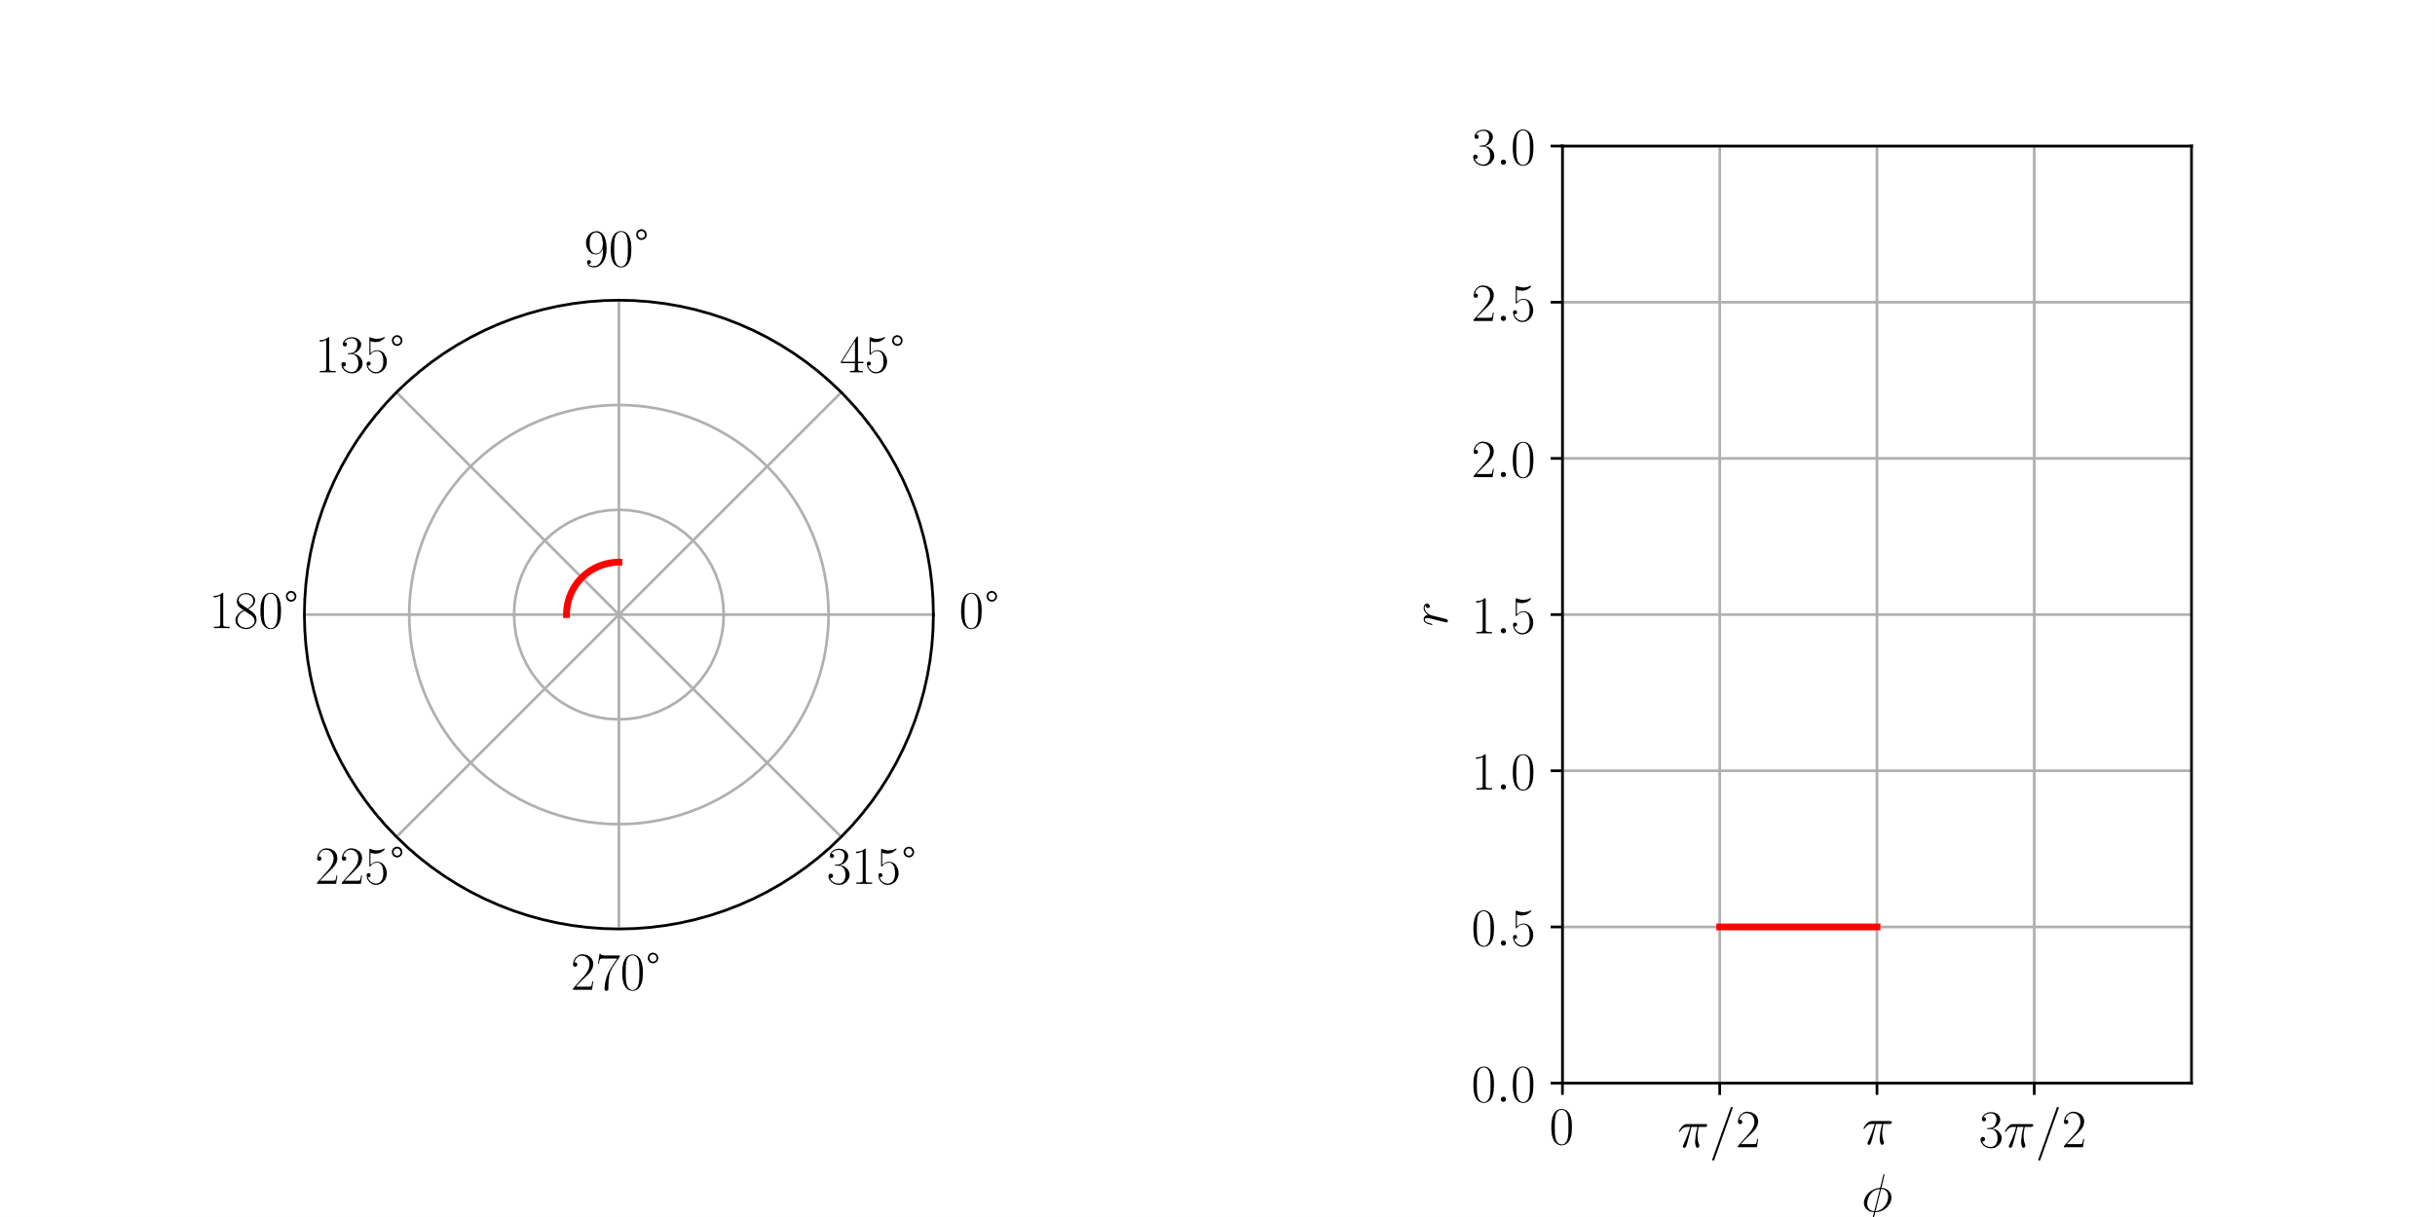
Manifolds and Metrics
Definition:
A manifold is a topological space that is locally isomorphic to euclidean space.
3

Slide 15
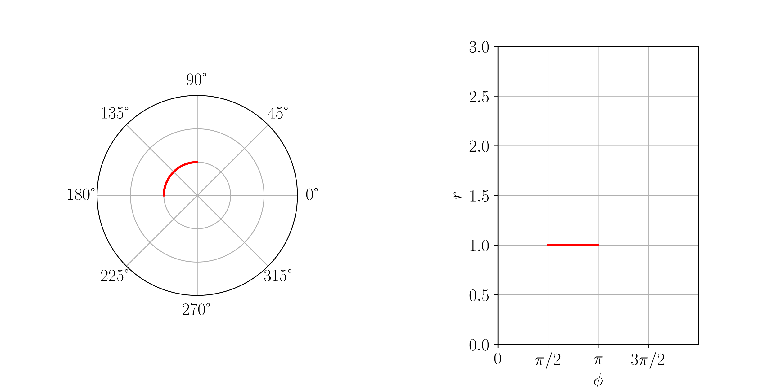
Manifolds and Metrics
Definition:
A manifold is a topological space that is locally isomorphic to euclidean space.
3

Slide 16
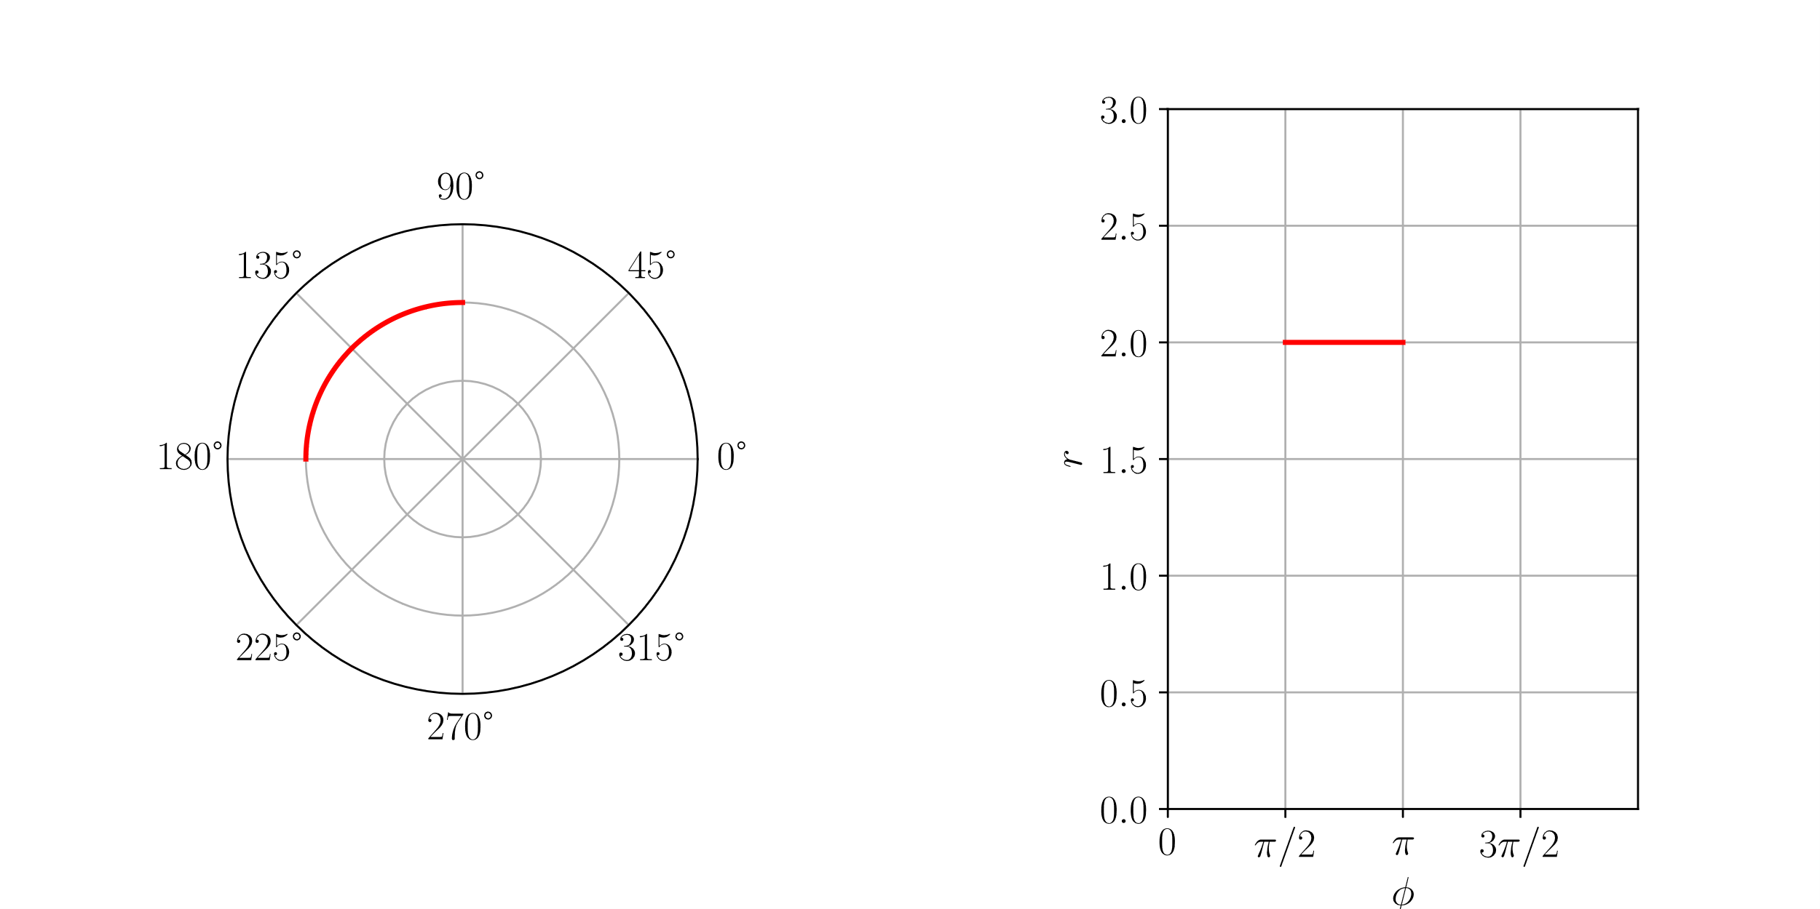
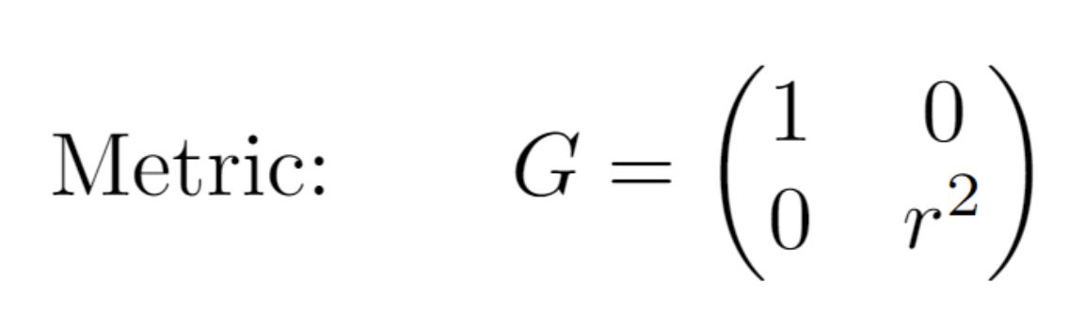
Manifolds and Metrics
Definition:
A manifold is a topological space that is locally isomorphic to euclidean space.
3

Slide 17
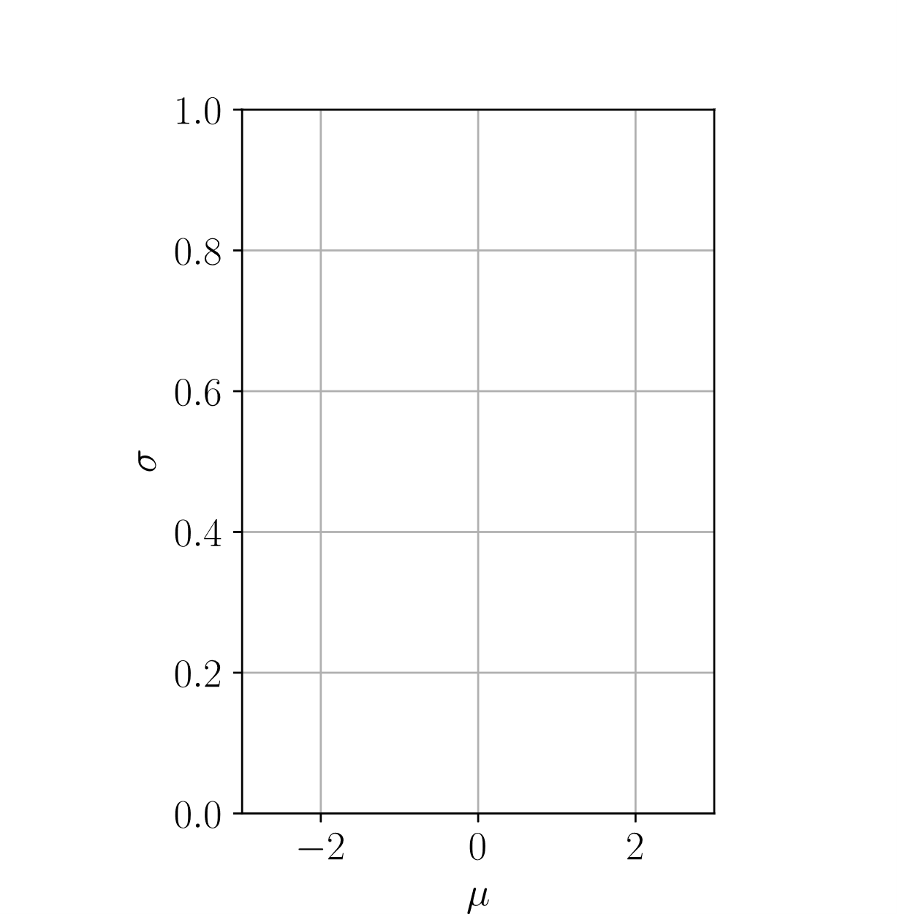
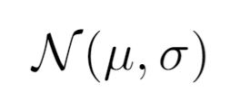
Statistical manifolds
4

Slide 18
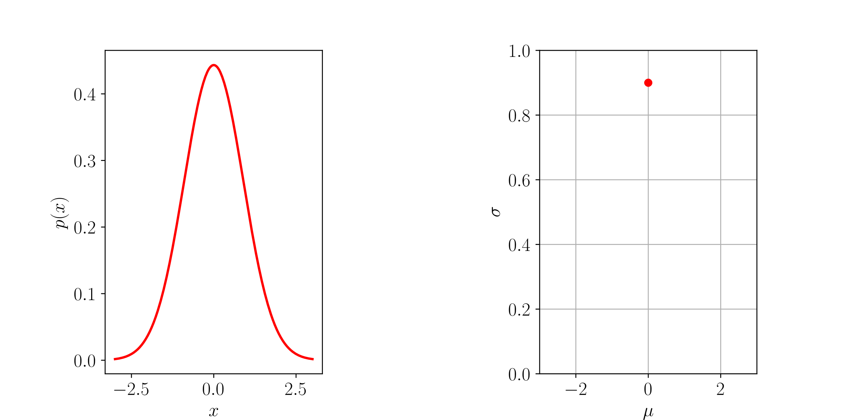
Statistical manifolds
4

Slide 19
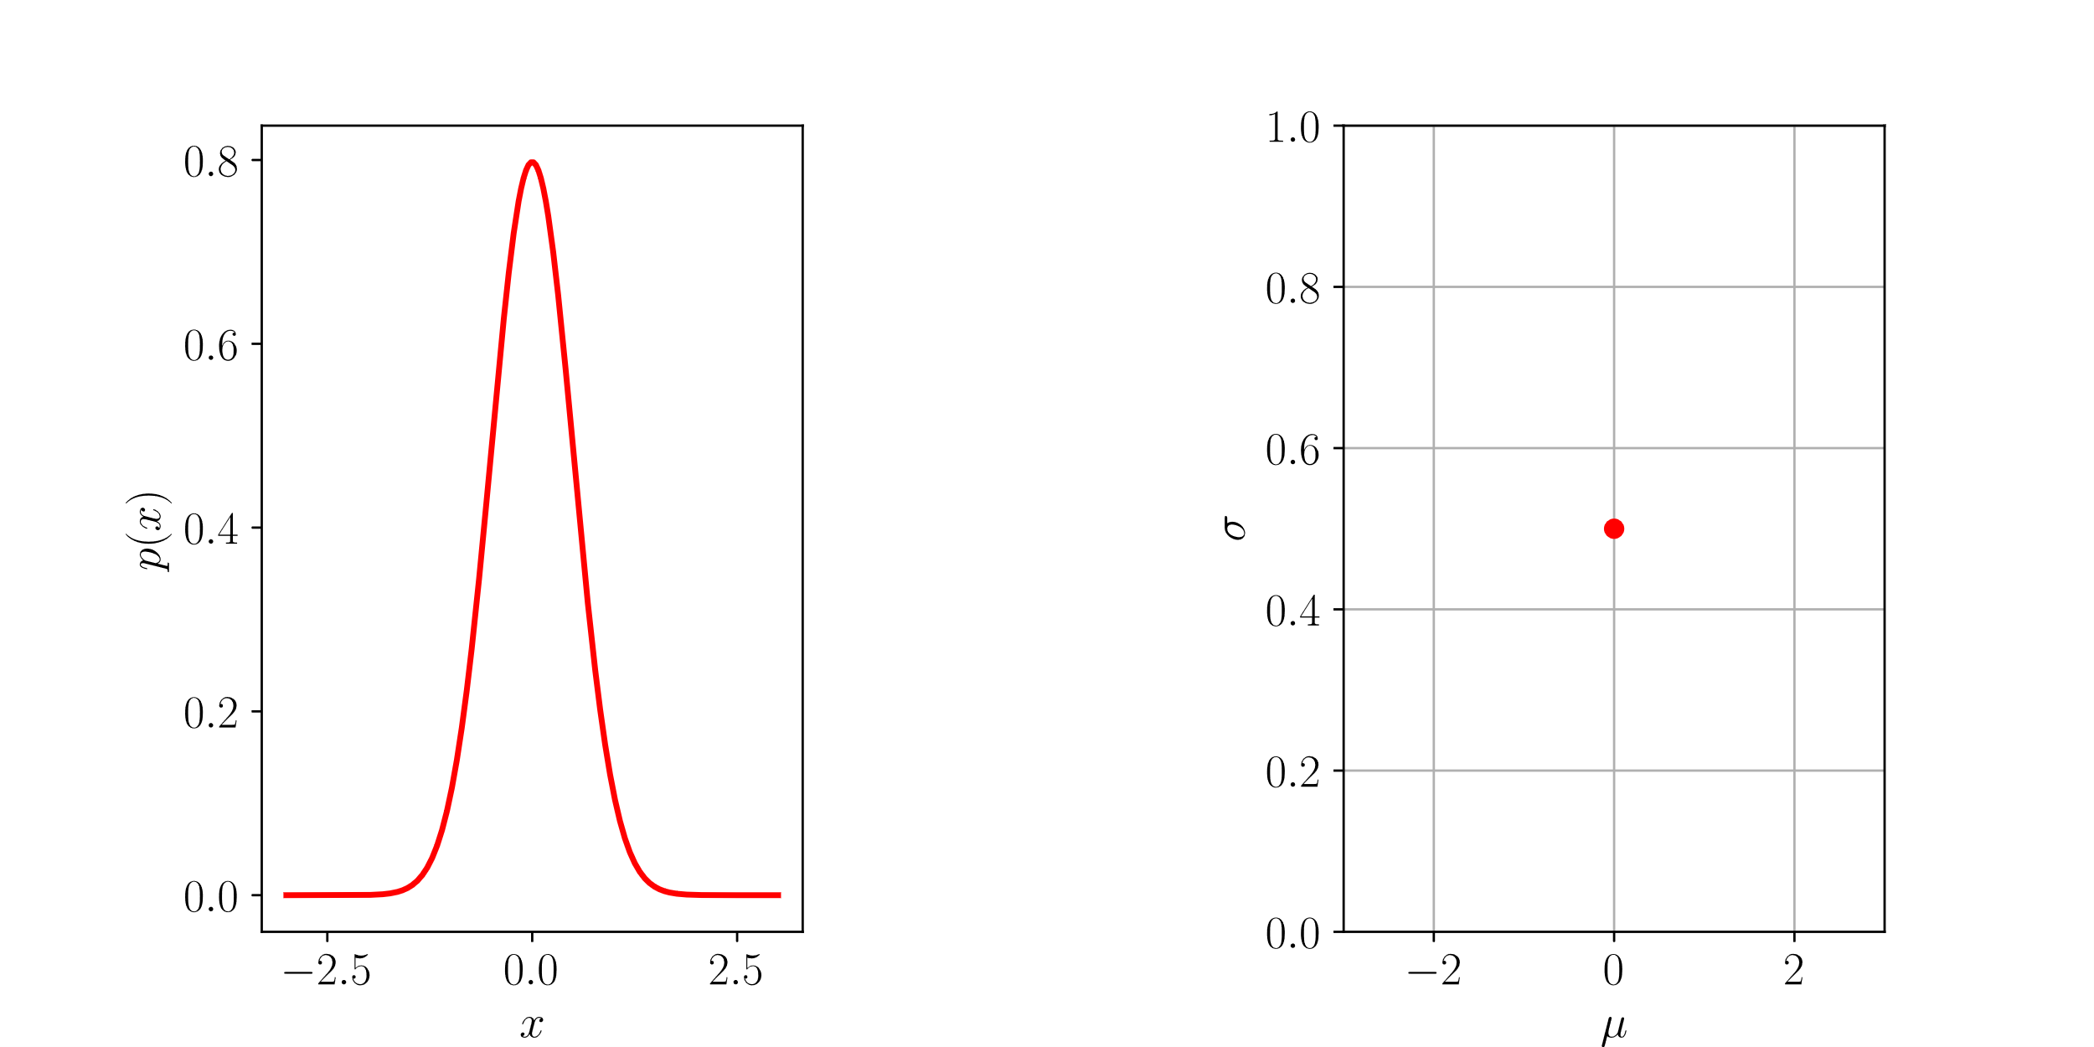
Statistical manifolds
4

Slide 20
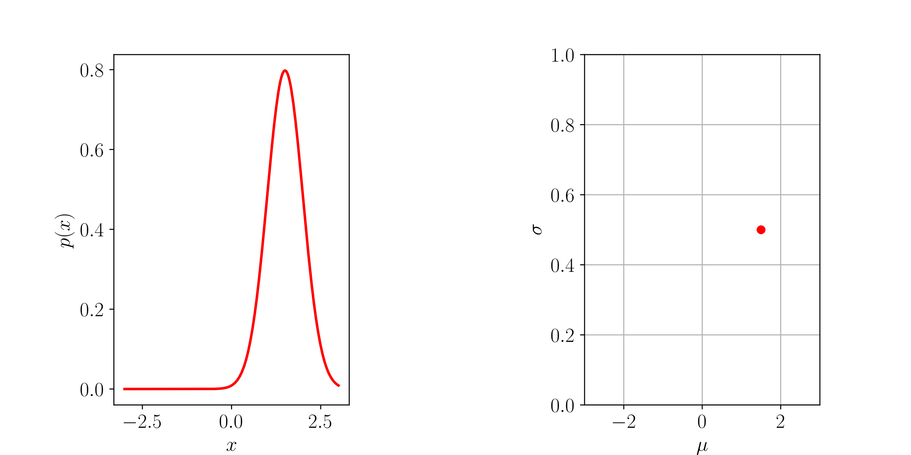
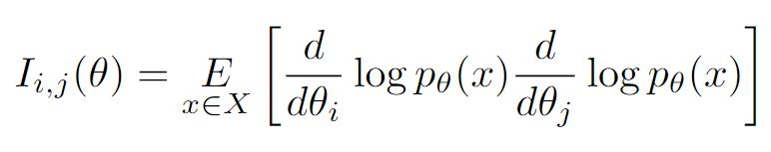
Statistical manifolds
4

Slide 21
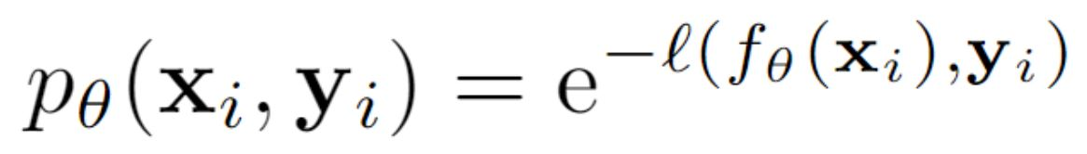
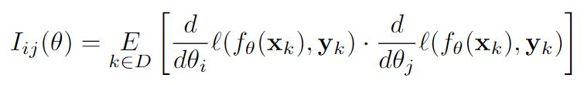
Statistical manifolds
Fisher information of a Neural Network:
5

Slide 22
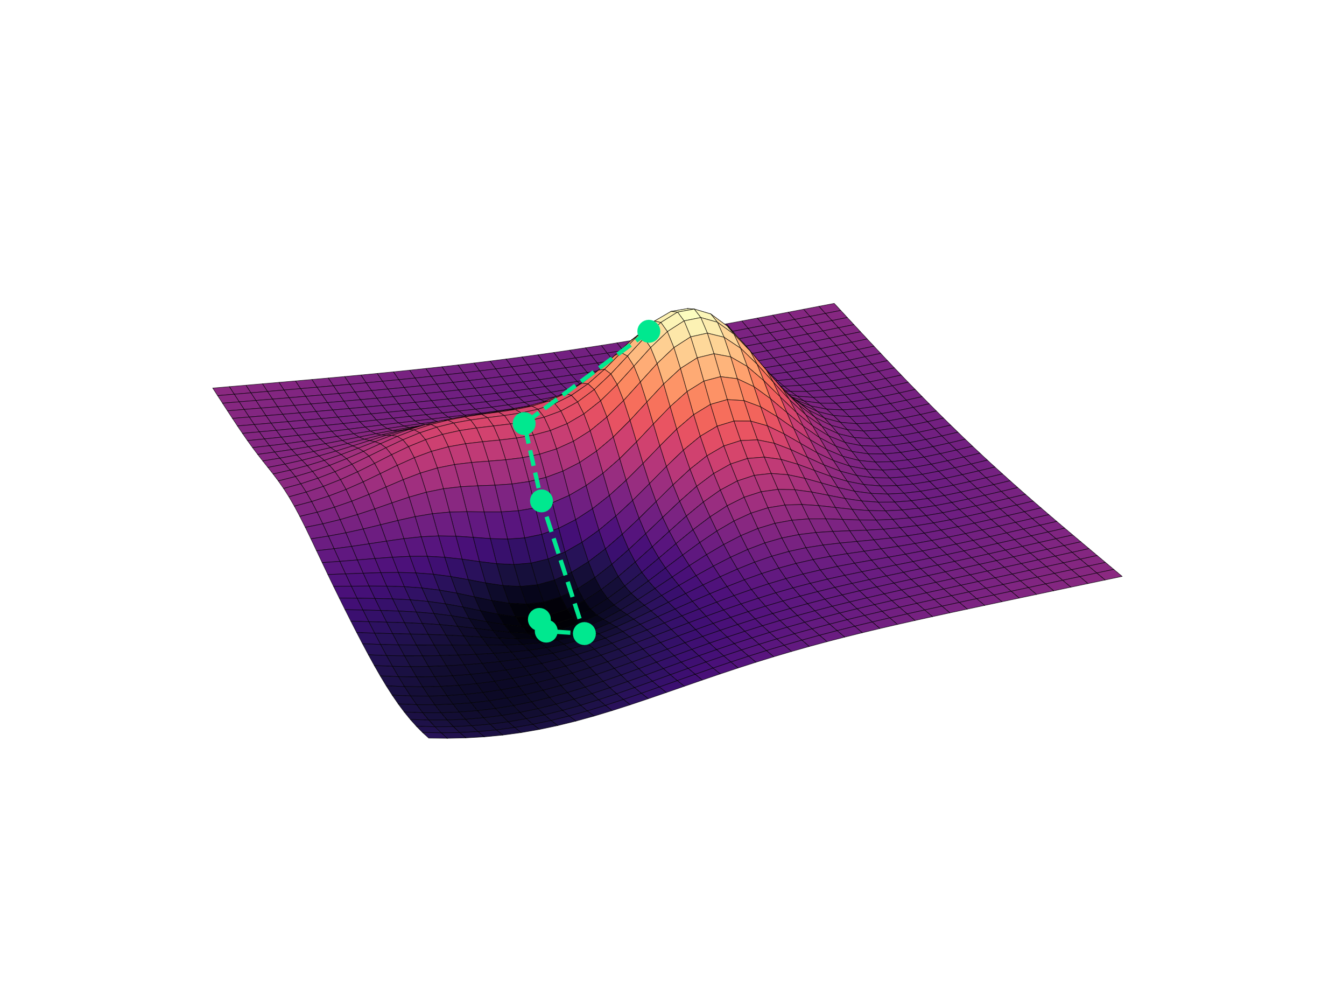

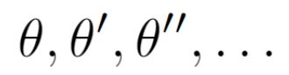
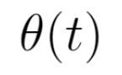
Neural Tangent Kernel
6

Slide 23
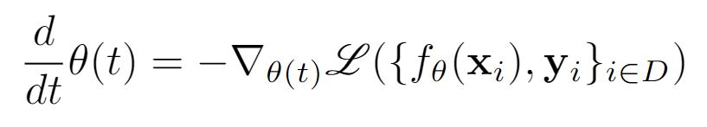
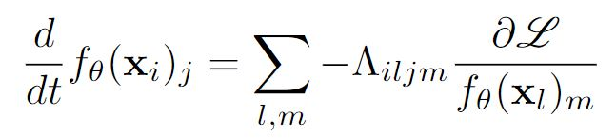
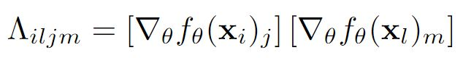
Neural Tangent Kernel
6

Slide 24
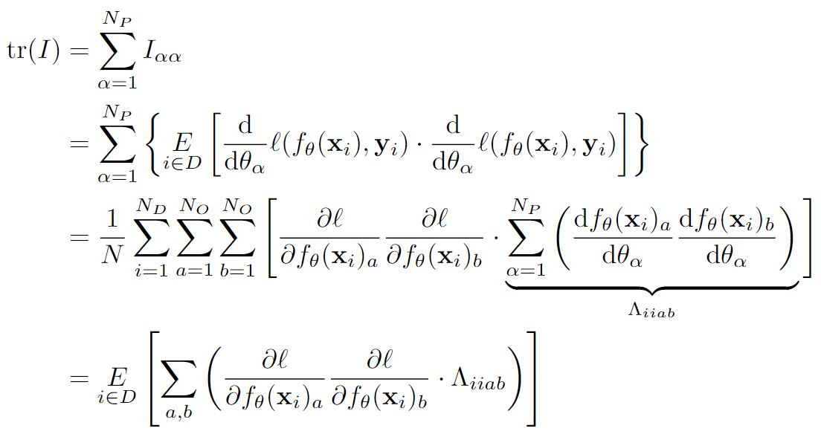
Relation between FI and NTK
7

Slide 25
Relation between FI and NTK
7

Slide 26
Relation between FI and NTK
7

Slide 27
Relation between FI and NTK
7

Slide 28
Relation between FI and NTK
7

Slide 29
Relation between FI and NTK
7

Slide 30
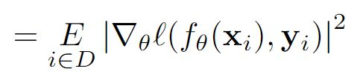
Relation between FI and NTK
7

Slide 31
Relation between FI and NTK
7

Slide 32
Relation between FI and NTK
7

Slide 33
Relation between FI and NTK
7

Slide 34
Relation between FI and NTK
7

Slide 35
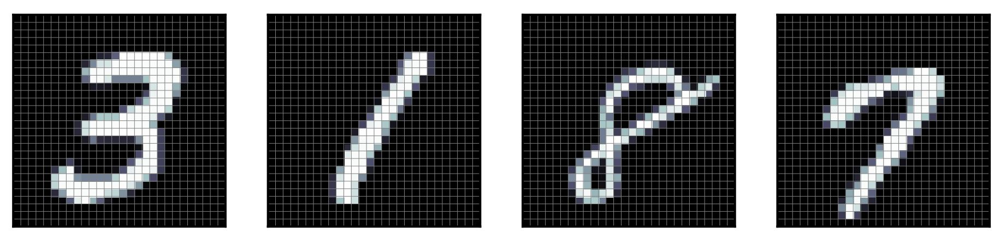
Experiments for Trace Comparison
MNIST Dataset:
8

Slide 36
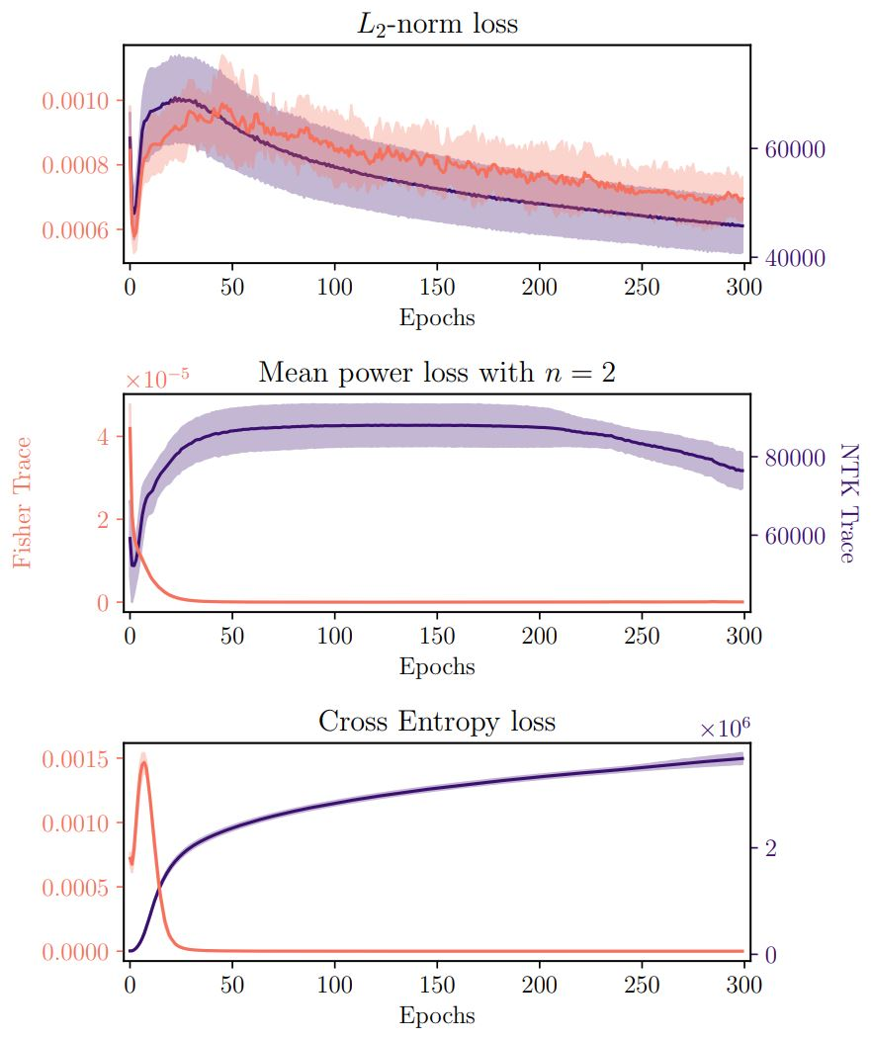
Experiments for Trace Comparison
8

Slide 37
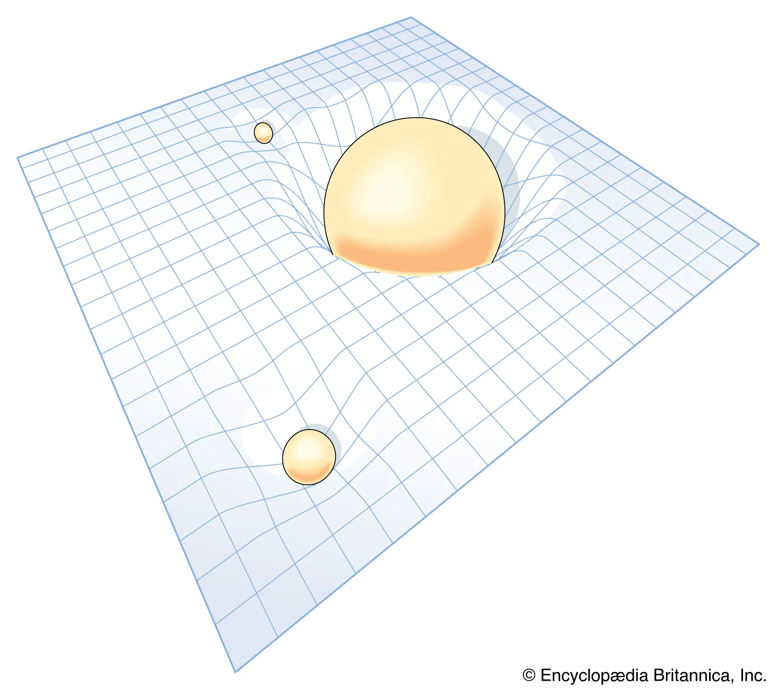
Curvature
https://www.britannica.com/science/relativity/Curved-space-time-and-geometric-gravitation
9

Slide 38
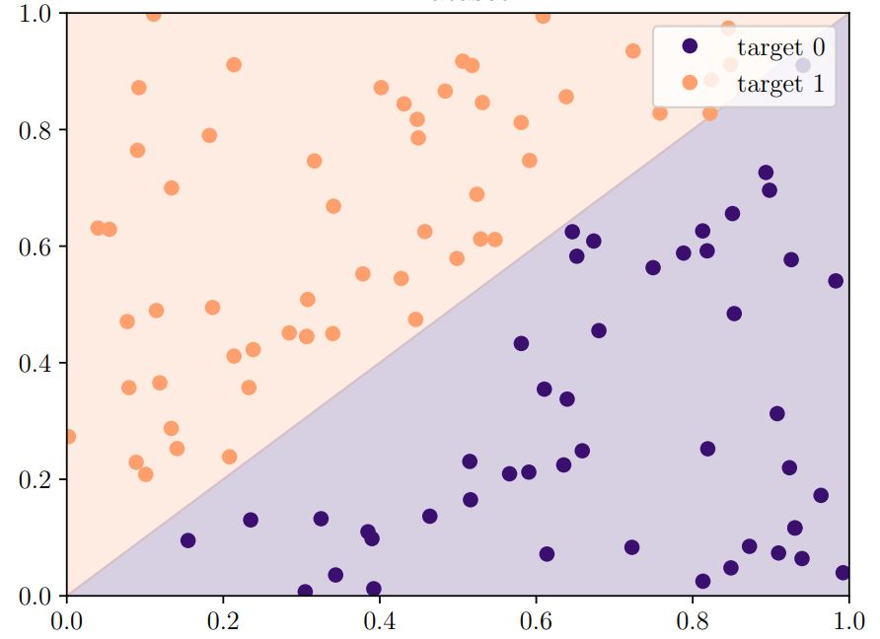
Curvature
9

Slide 39
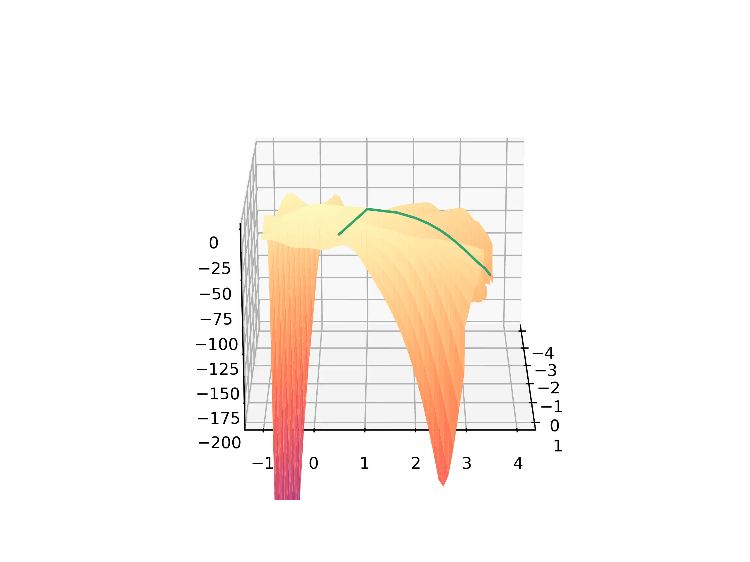
Curvature
Curvature for Lp-Norm Loss of order 2:
10

Slide 40
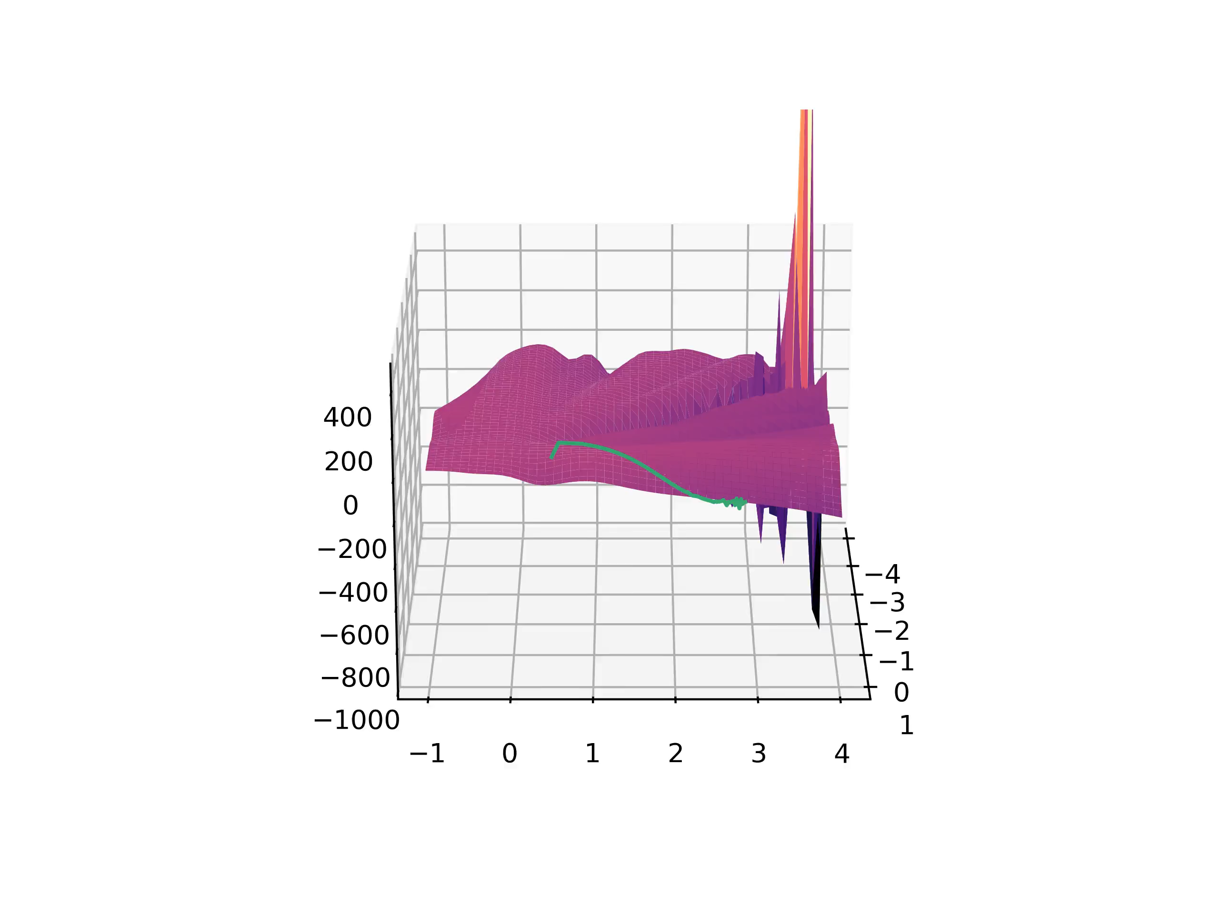
Curvature
Curvature for Mean-power Loss of order 2:
10

Slide 41
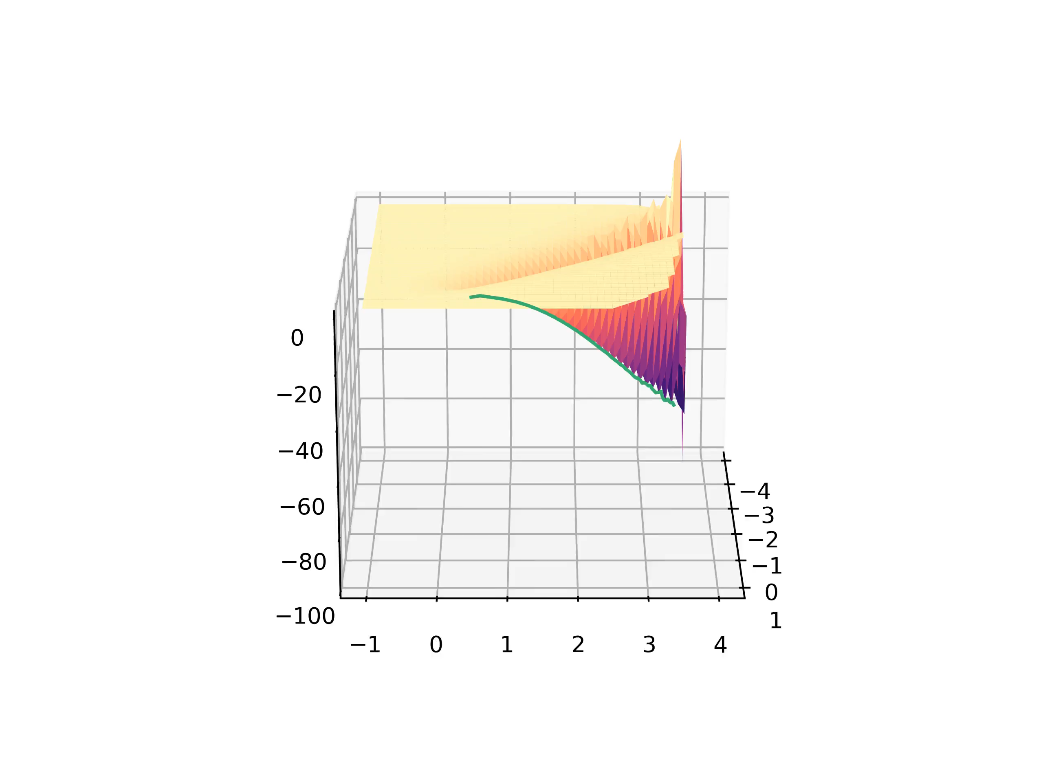
Curvature
Curvature for Cross-entropy Loss of order 2:
10

Slide 42
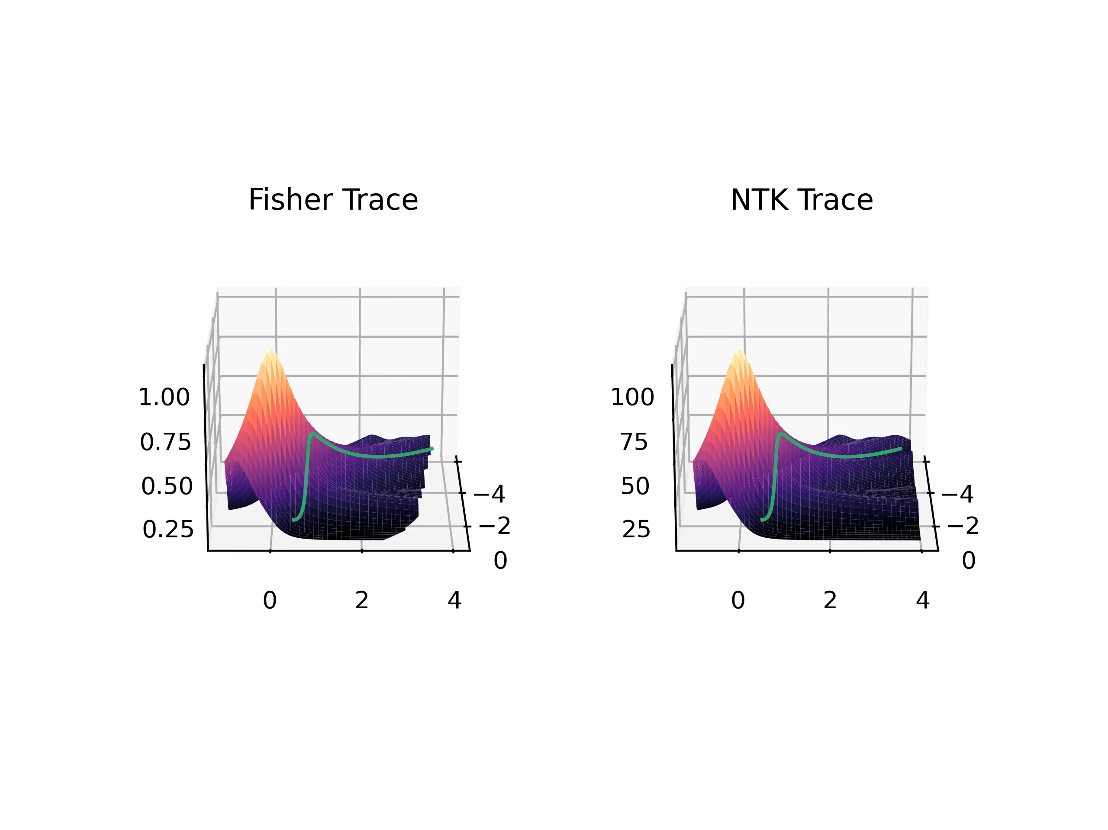
Further Results
Traces for Lp-Norm Loss of order 2:
11

Slide 43
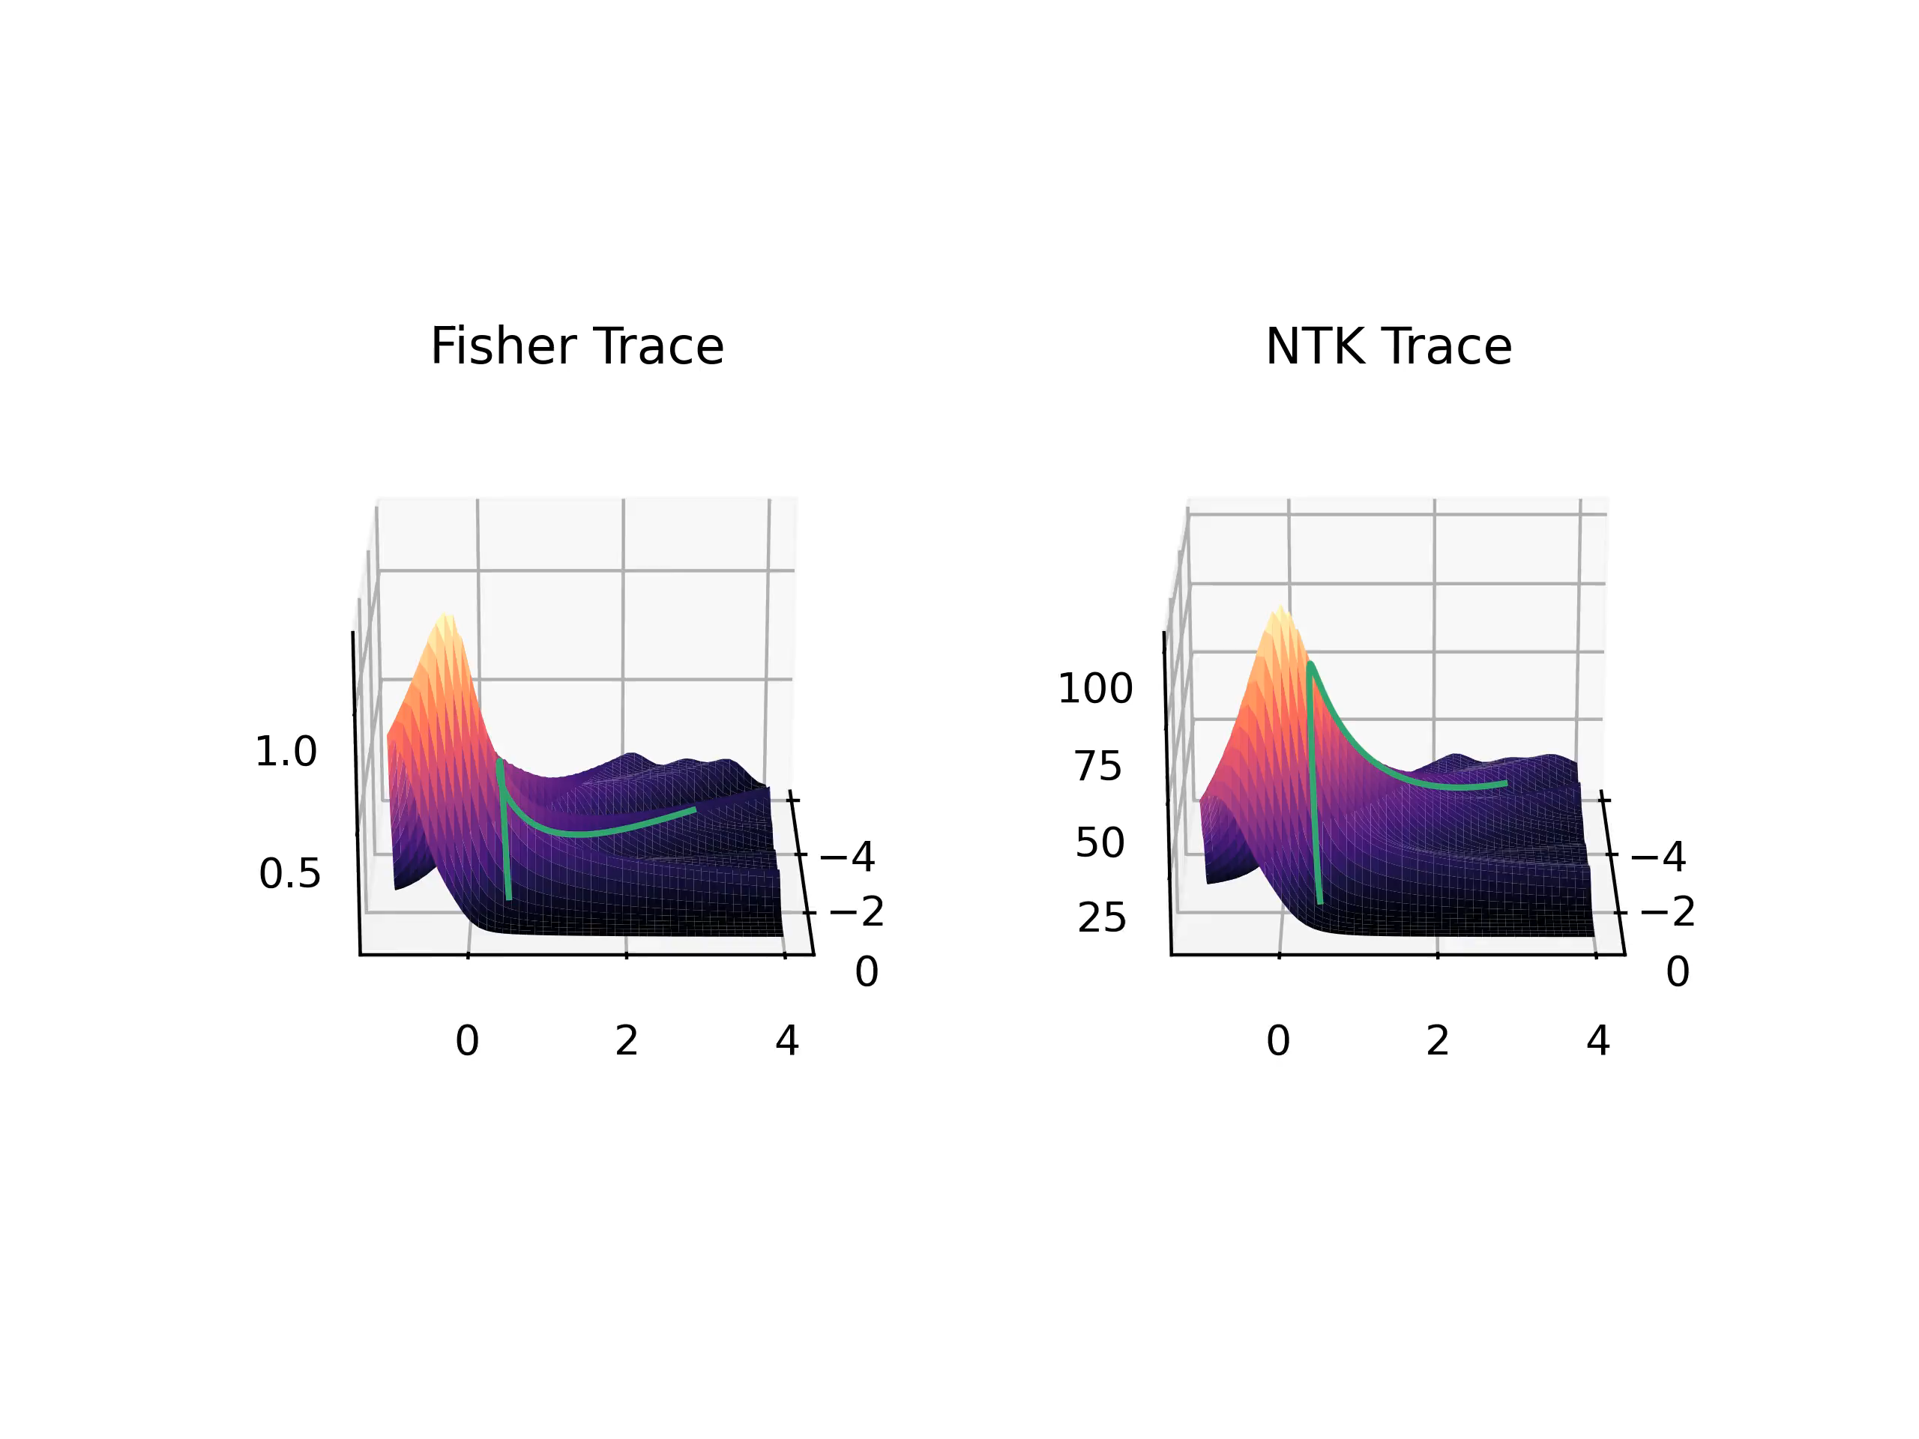
Further Results
Traces for Mean-power Loss of order 2:
11

Slide 44
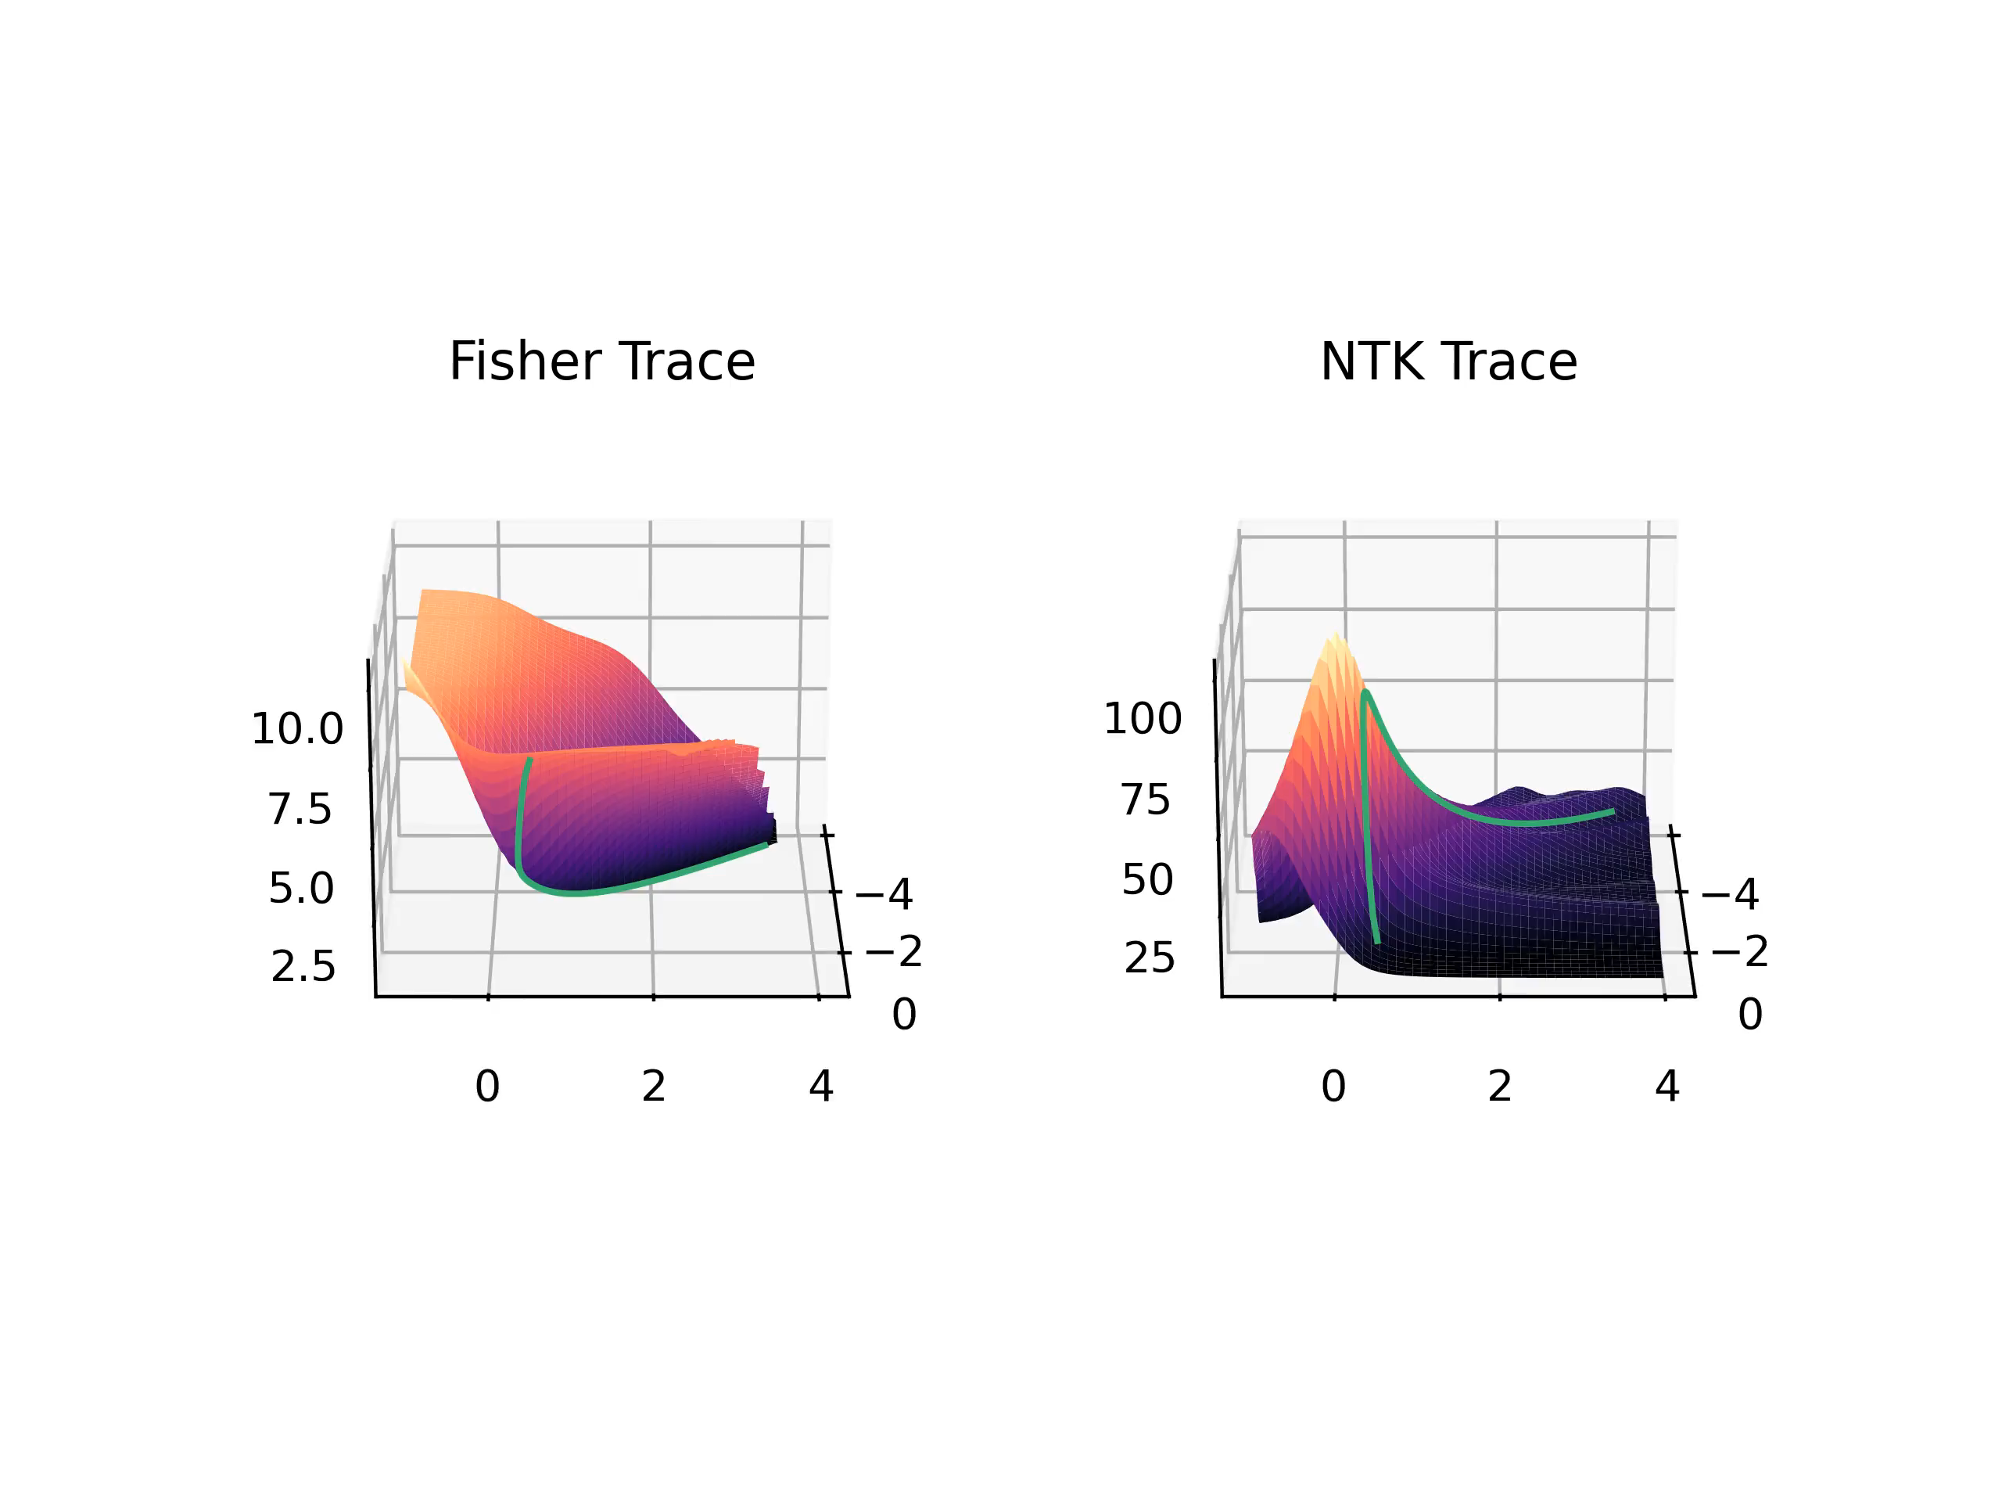
Further Results
Traces for Cross-entropy Loss:
11

Slide 45
Summary & Further Research
12

Slide 46
Summary & Further Research
What we looked at today:
How the Fisher Information describes the geometric properties of Neural Networks
How the NTK describes Neural Network behaviour in the output space
A relation between the trace of the Fisher Information of the NTK
Experiments investigating this relation
Further experiments that also include the scalar curvature calculated from the Fisher Information
12

Slide 47
Summary & Further Research
Further research possibilities:
Investigate further under which conditions the trace of the NTK is sufficient to determine the evolution of the trace of the Fisher information
Investigate what causes the different stages during training
Investigate if the curvature of the Network can yield information about training dynamics
Further Investigations using the trace of the Fisher Information
12

Slide 48
Questions
?

Slide 49
Backup Slides

Slide 50
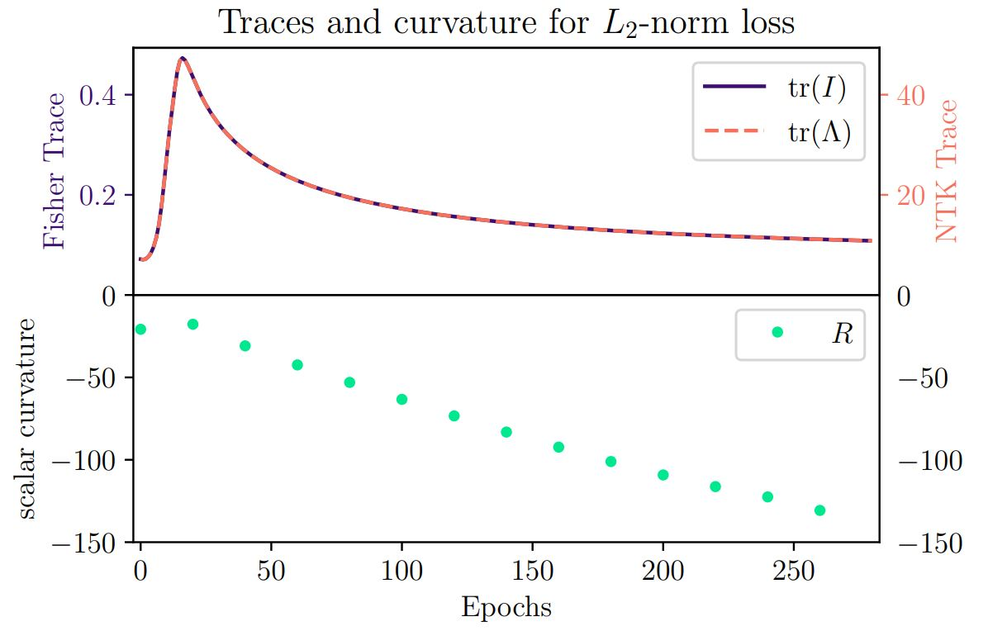
Comparison of traces and Curvature

Slide 51
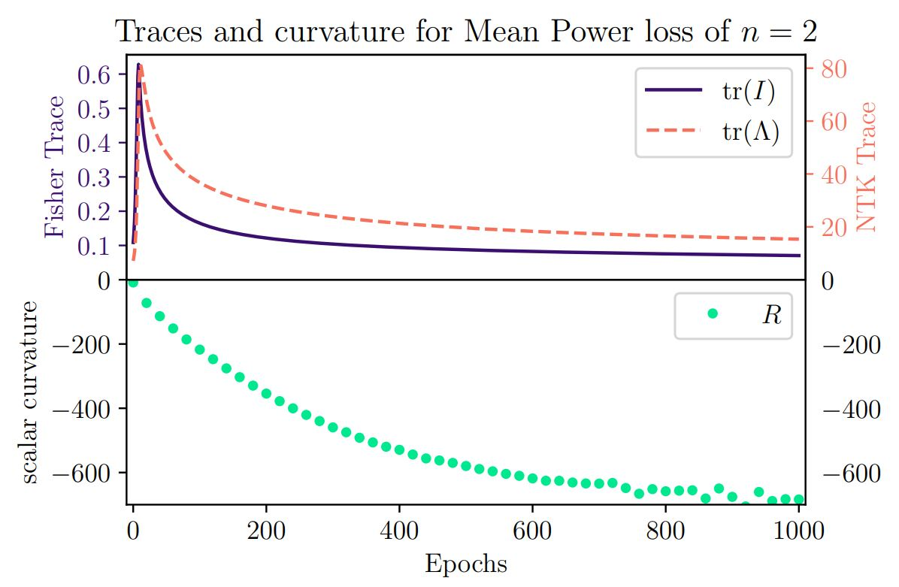
Comparison of traces and Curvature

Slide 52
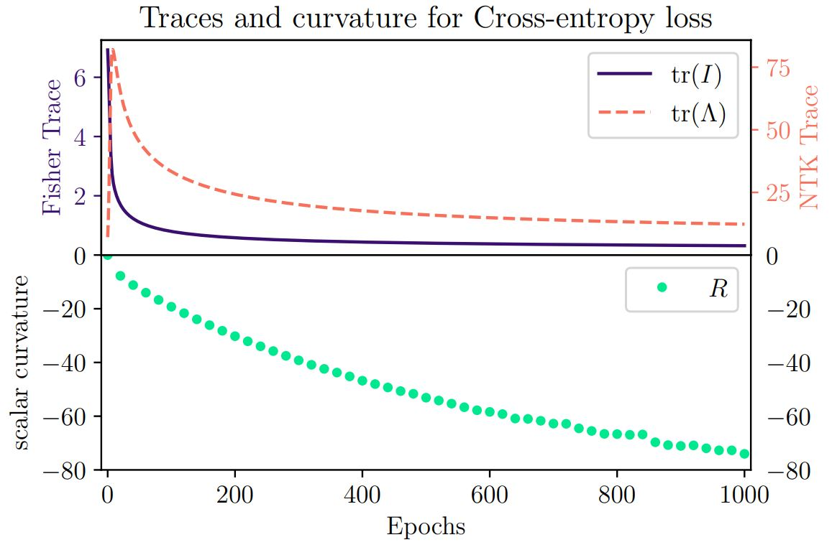
Comparison of traces and Curvature

